Slide 1
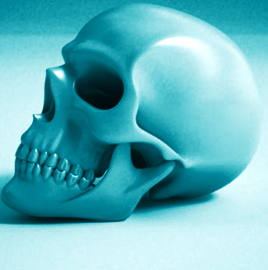

AnatoMyst v 1.0
App content:
Axial vs appendicular skeleton
A complete walkthrough
Anatomical parts
Cranial bones
Facial bones
Hand bones
Femur bones
Vertebral bones
Foot bones
Thoracic bones

